Slide 1

Road to Zero Trust
Navigating the Journey to a More Secure Future
By Randy Hinders
June 10, 2025

Slide 2

Zero Trust Session Agenda
The Evolving Threat Landscape & The Need for a New Approach
Introducing Zero Trust: A Mindset Shift
Core Principle: Assume Breach
Core Principle: Explicit Verification
Core Principle: Least Privilege Access
Core Principle: Microsegmentation
Core Principle: Data Security
Core Principle: Continuous Monitoring and Validation
Demo: Securing Access to Google Drive with Zero Trust Controls
Demo: Secure Remote Access to Legacy Apps with Cloudflare ZTNA
Q&A and Next Steps

Slide 3

Rethinking Perimeter Security Today
The "castle and moat" approach is outdated for cloud security.
Threats now originate from both internal and external sources.
Granular control is required, exceeding broad network access now.
Traditional perimeter security has proven ineffective in modern breaches.

Slide 4

Fortify Your Digital Fortress
Hardening security discourages most threat actors effectively.
Mandatory user training is crucial for security awareness.
Phishing and BEC remain primary attack vectors.
Make your environment a very hard target.

Slide 5

The Core Principle: "Never Trust, Always Verify"
Zero Trust shifts security to "never trust, always verify."
All users and devices require authentication and authorization.
Trust is earned, not assumed, and must be validated.
Every attempt to access resources needs rigorous verification.
NIST 800-207 for details and specifics.

Slide 6

Core Principle: Assume Breach
Assume breach is cornerstone of Zero Trust approach.
Attackers are already likely present within the environment.
How do you limit where they can go after they are in your network? (Live off the land.)
Security strategy is fundamentally changed by this mindset.

Slide 7

Core Principle: Explicit Verification
Verify all access before granting any user access.
Use multi-factor authentication (MFA) to ensure better security.
Authentication and authorization for users and devices are vital.
Determine context of the access like location or time.

Slide 8

Core Principle: Least Privilege Access
Grant only necessary access to perform assigned tasks.
Role-based access control is essential for implementation.
Minimum access reduces potential damage from security breaches.
Don’t use “elevated rights” accounts for day to day tasks.

Slide 9

Core Principle: Microsegmentation
Microsegmentation divides networks to limit lateral movement of threats.
Implement strict access controls between network segments effectively.
Contains security incidents within a specific network part.
Prevents the security incident from spreading further into network.
Create multiple moats and use IaC or SDWAN.

Slide 10

Core Principle: Data Security
Data Security is crucial for the organization.
Implementing DLP and encryption are critical steps.
Classifying data improves overall protection strategy.
Encrypt data when in flight with SSL and while at rest or in databases.

Slide 11

Core Principle: Continuous Monitoring and Validation
Monitor user behavior and device health always.
Regularly re-authenticate and re-authorize access requests.
Limit session times and require passphrases instead of passwords.
Ensure timely responses to security potential anomalies.
Are you checking for OS updates and security fixes?

Slide 12
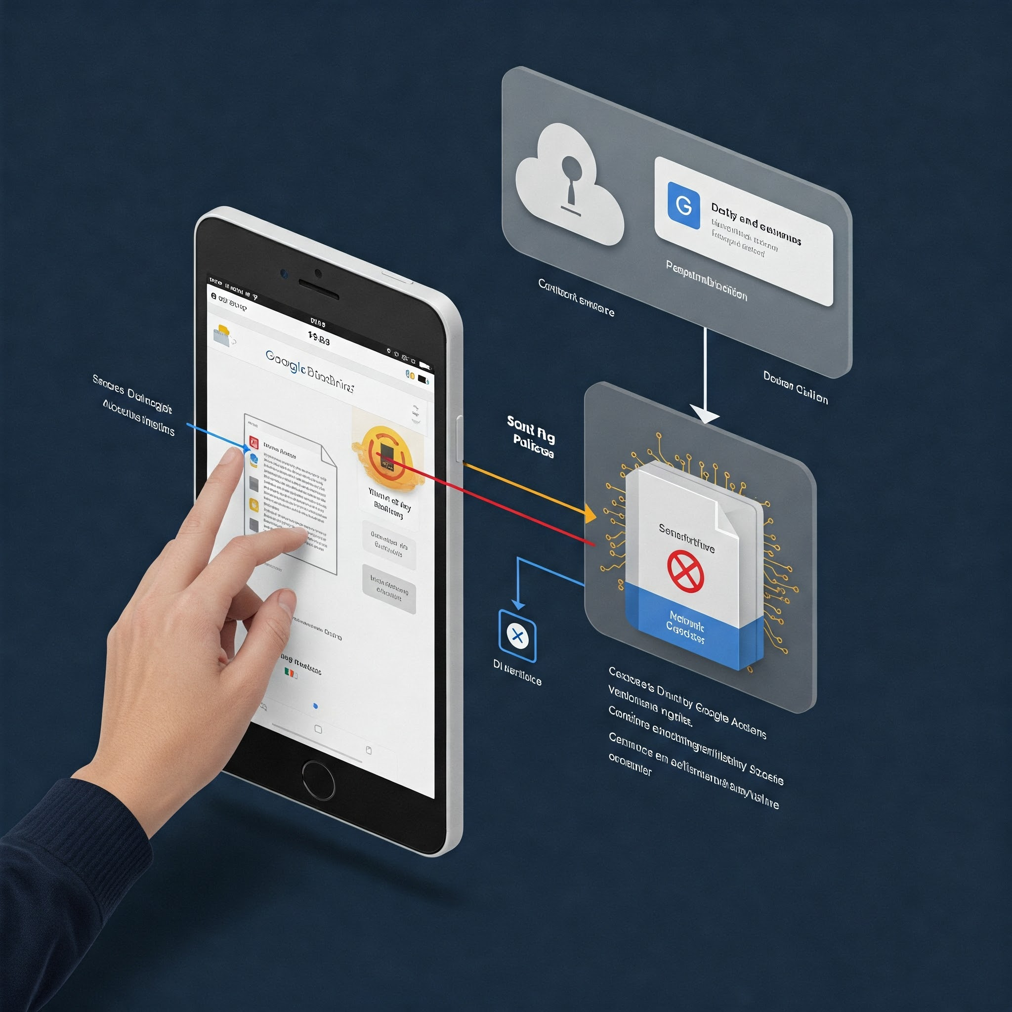
Google Drive Zero Trust Demo
Managed Chrome Profiles ensure trusted device access.
Context-aware policies utilize user, device, location for access.
Controls enforce "never trust, always verify" for sensitive data.
Demonstration will focus on Google Drive security measures.

Slide 13

Legacy Apps: ZTNA Cloudflare Demo
Secure access to web apps without VPN.
Cloudflare ZTNA enforces Zero Trust principles well.
Demonstrating secure remote access for legacy apps.
Wide range of scenarios apply Zero Trust to we will see SSH and Web App.

Slide 14

Q&A
Centralized identity management is crucial for Zero Trust. What are some challenges you've faced with managing identities and access in your current environment?
MFA is a foundational element. Beyond passwords, what other authentication factors are you considering or currently using?
Network Segmentation with VLANs: Limits lateral movement of threats; How do you segment your network?
Provides continuous monitoring for anomalies; What tools are used for monitoring?

Slide 15

Zero Trust: Continuous Validation
Monitor user behavior and device health consistently.
Regularly re-authenticate and re-authorize access.
Ensure timely responses to potential security anomalies.

